Slide 1
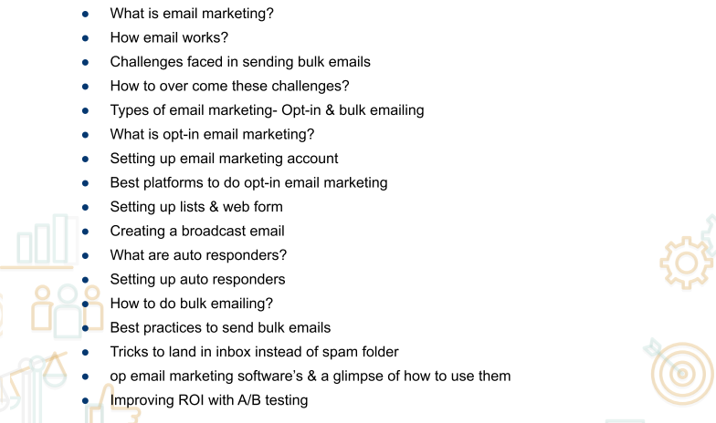
Email marketing

Slide 2
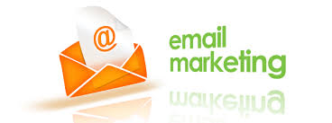
Email Marketing
Email marketing is the act of sending a commercial message, typically to a group of people, using email. In its broadest sense, every email sent to a potential or current customer could be considered email marketing.
It usually involves using email to send advertisements, request business, or solicit sales or donations, and is meant to build loyalty, trust, or brand awareness. Marketing emails can be sent to a purchased lead list or a current customer database.

Slide 3
History
Email marketing has evolved rapidly alongside the technological growth of the 21st century. Prior to this growth, when emails were novelties to the majority of customers, email marketing was not as effective. In 1978, Gary Thuerk of Digital Equipment Corporation (DEC) sent out the first mass email to approximately 400 potential clients via the Advanced Research Projects Agency Network (ARPANET). This email resulted in $13 million worth of sales in DEC products, and highlighted the potential of marketing through mass emails. However, as email marketing developed as an effective means of direct communication, users began blocking out content from emails with filters and blocking programs. In order to effectively communicate a message through email, marketers had to develop a way of pushing content through to the end user, without being cut out by automatic filters and spam removing software. This resulted in the birth of triggered marketing emails, which are sent to specific users based on their tracked online browsing patterns.
Historically, it has been difficult to measure the effectiveness of marketing campaigns because target markets cannot be adequately defined. Email marketing carries the benefit of allowing marketers to identify returns on investment and measure and improve efficiency.[citation needed] Email marketing allows marketers to see feedback from users in real time, and to monitor how effective their campaign is in achieving market penetration, revealing a communication channel's scope. At the same time, however, it also means that the more personal nature of certain advertising methods, such as television advertisements, cannot be captured.

Slide 4
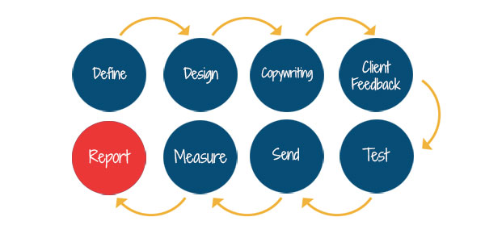
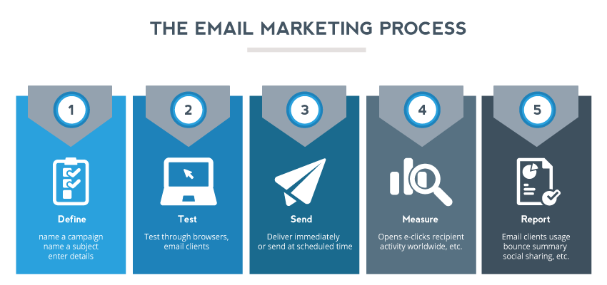
E-Mail Marketing process

Slide 5
How Email Work
The sender composes a message using the email client on their computer.
When the user sends the message, the email text and attachments are uploaded to the SMTP (Simple Mail Transfer Protocol) server as outgoing mail.
All outgoing messages wait in the outgoing mail queue while the SMTP server communicates with the DNS (Domain Name Server–like a phone book for domain names and server IP addresses) to find out where the recipient’s email server is located. If the SMTP server finds the recipient’s email server, it will transfer the message and attachments. If the recipient’s server can’t be found, the sender will get a “Mail Failure” notification in their inbox.
The next time the recipient clicks “Send & Receive,” their email client will download all new messages from their own email server. You’ve got mail!

Slide 6
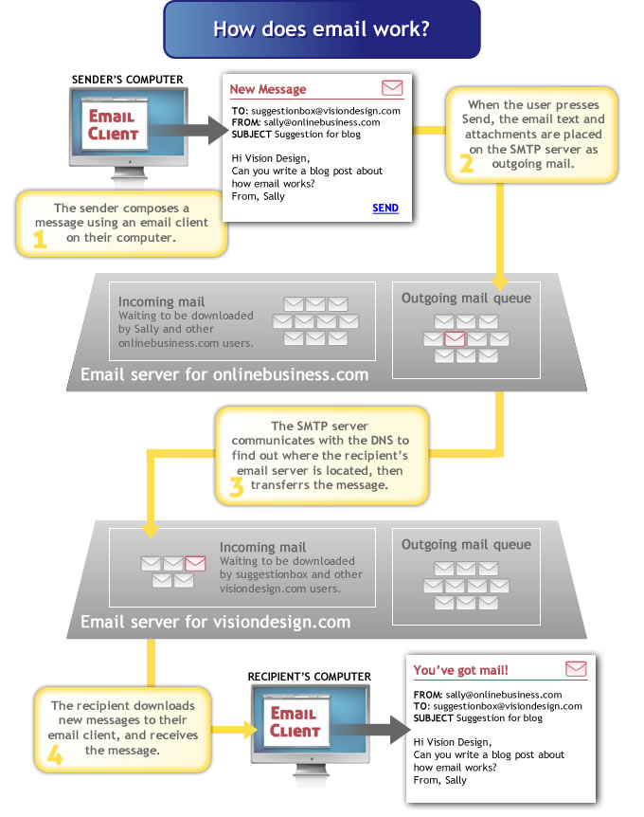
Email

Slide 7
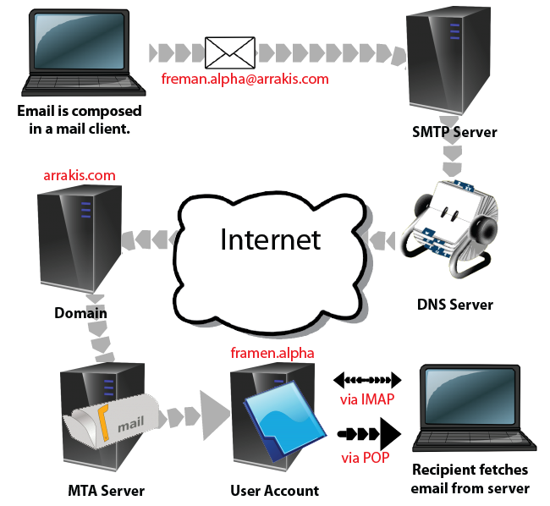
How Email work

Slide 8
Advantages
• Affordable • Simple and quick • Personal and customizable • Relationship focused • Action oriented • Measurable • More popular than social media • Mobile and global

Slide 9
Some stats and figures related with email marketing
• As of 2013, there are 3.6 billion email accounts
• 91% of consumers check their email daily
• 74% of consumers prefer to receive commercial communications via email
• The average click-through rate for B2B marketing emails in Q2 2013 was 1.7%
• 60% of marketers believe email marketing produces positive ROI
• 66% of consumers have made a purchase online as a result of an email marketing message
• Email marketing has an ROI of 4,300%

Slide 10
Some stats and figures related with email marketing
• 76% of email opens occur in the first two days after an email is sent
• 48% of emails are opened on mobile devices
• Email marketing as a channel was the third overall lead generation source for marketers in 2013, producing 13% of all leads.
• People who buy products marketed through email spend 138% more than people that do not receive email offers.
• 37% said that more than 20% of their inbox comes from marketers, and 53% said they’re happy with the number of marketing emails they get.Hence, it is evident from the stats that selling your product through email marketing can be far easier than what it is in other marketing channels if you know the ways to carry it out effectively.However, in spite of being a powerful marketing channel, there are a few challenges that are associated with email marketing. Let me go ahead and acquaint you with the most common challenges with resolutions to them.

Slide 11
Email Marketing Challenges
Earning New Subscribers
Earning new subscribers: is the biggest challenge.The best way to overcome the issue of earning new subscribers is to clearly state the benefits to your customers. Having a clear value proposition will help in answering the key concerns people have before hitting that opt-in button. Maybe you’re providing meaningful product updates or giving special offers that aren’t available anywhere else online.
Increasing Open Rates
There are a number of ways you can increase the open rate for your marketing emails. Your focus should be writing eye-catching email subject lines because it’s the first thing recipients will notice about your message. You'll need to craft a subject line that's short and concise to immediately grab the attention of the recipient.
Great subject lines make subscribers want to read the rest of the email.
Notes:
A recent study revealed that the average email list exhibits a depreciation of 25% every year.

Slide 12
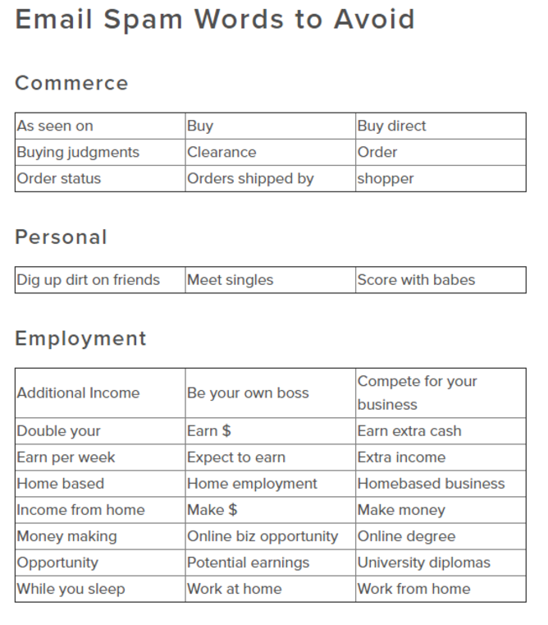
Improving Deliverability
It won’t matter if you craft a compelling email with an interesting subject line if all your emails get sent straight to the spam box. Passing the spam filter has always been one of the huge email marketing challenges for marketers. There are also deliverability issues arising out of a full inbox or non-existent email address.
When your deliverability rate is exceptionally low, you may get blocked by Internet service providers. Low deliverability is also a sign of wasted time, money and effort.
Solution
You can avoid getting filtered into the spam box by avoiding spam words in your subject lines. The variety of words that can set of spam filters varies by industry. However, some common examples include: buy, cash, earn $, save $, sale, subscribe, make $, click, free, trial, cost, cheap, prize, and unlimited. Avoid these as much as possible to thwart email marketing challenges.

Slide 13
Email Marketing Challenges
Retaining Subscribers
What’s the point of growing your email list if you’re also losing subscribers every minute? According to the Campaigner report, retaining current subscribers makes it to the top five biggest email marketing challenges for marketers. If you have a bunch of active subscribers, make every effort to keep them.
Solution
The best way to ensure that your current subscribers continue to subscribe is by sending out relevant emails to the right audience. This means that you'll have to correctly segment your email subscription list. Using segmentation, you can address the different pain points of various buyer personas. According to Lyris, email list segmentation results in a lower unsubscribe rate for 28 percent and greater customer retention for 21 percent of marketers.

Slide 14
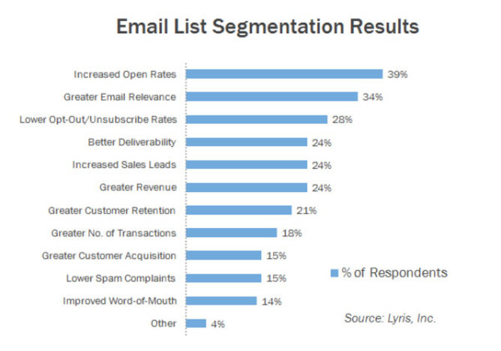
Email Marketing Challenges

Slide 15
Email Marketing Challenges
Low Click-Through Rates
Another of the top email marketing challenges for marketers is improving email click-through rates and maintaining a constant number. Even if recipients open your emails, it doesn’t mean they’ll read through the entire thing and click on the links inside. If they're not clicking, you don’t have a good chance of converting them into paying customers.
Solution
Email list segmentation not only helps with subscriber retention but also with click-through rates. Yet your low click-through rates may be simply a result of disinterested subscribers. What you can do to fix this issue is run a re-engagement campaign every year. Send out emails asking subscribers if they want to keep receiving your emails and offer an opt-out option.
Low click-through rates can also be email marketing challenges because you’re sending emails too frequently. In fact, The Relevancy Group and LiveClicker conducted a research study which found that high frequency of emails was the biggest reason why consumers disliked getting marketing emails on their phone. Give subscribers the chance to customize the frequency based on their preferences.

Slide 16
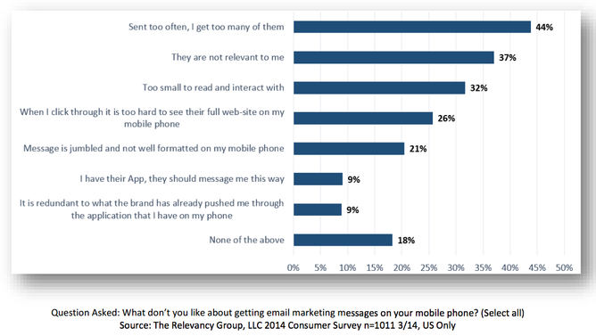
Email Marketing Challenges

Slide 17
Email Marketing Challenges
6. Achieving Measurable ROI
Last but not least, measuring the performance of campaigns is another of the significant email marketing challenges. As a result, marketers often have difficulty in achieving measurable ROI. Maybe you saw a four percent increase in CTR for your latest email blast, but did you experience any increase in conversions or leads?
Solution
Closed-loop marketing can help you in achieving measurable ROI for resolving your email marketing challenges. Close-loop marketing would require you to follow a subscriber from the first point of contact (visiting your website) to their final conversion into a paying customer.

Slide 18
Email Marketing Challenges
Opt-In Email Marketing?
Opt-in email marketing is a marketing campaign that uses permission-based email-collection methods to capture email addresses from willing consumers. Once you have a potential customer’s email, you can add it to a marketing list based on the customer’s position in the sales funnel.
For instance, if your prospect signs up for your email list during his or her first interaction with your brand, you might segment that consumer into a list that introduces your online courses and provides actionable tips for interested consumers.
However, if your prospect joins after buying a course, you could send emails about getting the most out of your course material or about applying the information you teach to the real world.
Opt-in email marketing isn’t just a way to capture email addresses so you can blast prospects with sales copy. In fact, that’s the worst way to use it.
Instead, use opt-in email marketing to nurture your prospects through the sales process.
Invite prospects to interact: Let your email marketing recipients know where to find you online, from your social media accounts to your blog.
Encourage customers to convert: Provide sound reasons why a prospect should buy one of your courses. Use real-world examples to illustrate your points whenever possible.
Follow up with prospects: If a prospect abandons his or her shopping cart or goes inactive for a while, reconnect with a nurturing email that reminds him or her that you exist.
Send promotions: Offer discounts and other promotions that encourage prospects to buy your course for the first time or to buy a subsequent course.

Slide 19
Email Marketing Challenges
Set up your opt-in email marketing campaign based on your specific objectives. Every course creator has different goals, so you don’t want to copy someone else’s campaign. Instead, think of the goals you want to reach, then design emails that help push customers to help you reach them.
Gain brand visibility: If you want to establish yourself as an authority figure in your industry and make more people aware of your brand, encourage your email opt-ins to share your messages. The more people forward your emails, the more signups you get.
Boost sales: Use promotions, bundles, and discounts to get people to finally hit the “buy” button.
Increase upsells: Encourage customers to buy multiple courses and other digital products.
Check on progress: Find out where your customers are in their online courses and whether they need any assistance or have any feedback.
Solicit reviews: Ask your customers to review your courses online. You’ll get backlinks as well as more brand visibility. Plus, prospective customers will feel more comfortable buying from you. In fact, nearly 85 percent of respondents to a study stated that they trusted online reviews as much as they valued recommendations from friends.

Slide 20
Best Practices for Gathering Permission-Based Email Subscriptions
Now that you’re ready to collect email addresses using a permission-based opt-in program, use these tips to increase engagement and improve the outcome of your efforts.
Add your email opt-in form to every page on your website and blog. You want as many people as possible to see it.
Segment your audience based on their behavior. For instance, someone who has never interacted with your business before doesn’t belong on the same list as a person who has bought one of your courses in the past.
Use double authentication and other strategies if you want to build the strongest list possible. When you narrow down your list to the people who truly want to be there, you’ll build an audience of highly engaged, ready-to-convert leads.
Mix up your email content. One week, for instance, you might send a coupon code for a discount on your courses. The next week, send an educational email that teaches your subscribers how to solve a problem or reach a goal.
Track your metrics. Pay careful attention to open rates, engagement rates, bounce rates, and other metrics that might inform future efforts.
Invite subscribers to share your emails. Ask them to forward them to interested family and friends. Those people might become direct subscribers.
Never forget a call to action. You want each email to drive your subscribers toward a specific next step, such as buying your course.

Slide 21
Opt-In Email Marketing Vs. Bulk Email Spam
Though many people practice email marketing to promote their goods and services, some don't know the difference between spam and opt-in email marketing. It's understandable. As the years have progressed, many sources have blurred the line between opt-in and bulk email spam for their own purposes. However, we've defined both here.
Spam vs. opt-in email: definitions
Bulk email spam: Spam is any email sent for commercial purposes without permission from the receiver. This means that if you're sending emails to your friends, family and colleagues, it does not qualify as spam. However, if you're sending a batch of emails to people who never asked to receive them from you, promoting your latest line of shaving products, you're most definitely sending spam.
Opt-in email: Opt-in email is any commercial email sent to people who have specifically signed up to receive it. Permission, in this respect, is clear-cut. If you have a list based on people who have signed up to receive emails about travel in general but not your travel agency, it doesn't qualify as specific permission. If you have a list of people who have agreed, in some form of writing, link clicking or other evidence, that they want to receive

Slide 22
Opt-in email: advantages
Preserves your email marketing reputation
Shows customers that you respect their privacy
Helps you email people who are interest in what you're selling
Saves you time and money by micro-focusing your list
Lets you be more targeted in your campaigns
Helps you build long-term, trust-based relationships with customers
Can boost your sales and product interest

Slide 23
disadvantages of sending bulk email
The disadvantages of sending bulk email spam:
Your recipients will be unresponsive
You'll waste time sending to an unresponsive audience
You'll waste money sending emails to people who don't want them
You'll ruin your email marketing reputation
You'll ruin the reputation of your company or business
You'll see your open and click-through rates drop

Slide 24
Best Email Marketing Software & Automation Tools
HubSpot CRM
Wix ShoutOut
MailChimp
Zoho Campaigns
Elastic Email
MailJet
Benchmark
SendinBlue
MailerLite
NetHunt
VerticalResponse
Reachmail
Sendpulse
Mad Mimi
Campayn

Slide 25
Mail Chimp
MailChimp is a marketing automation platform and an email marketing service and a trading name of its operator, Rocket Science Group, an American company founded in 2001 by Ben Chestnut and Dan Kurzius. MailChimp began as a paid service and added a freemium option in 2009. Within a year its user base had grown from 85,000 to 450,000. By June 2014, it was sending over 10 billion emails per month on behalf of its users. In 2017, the company was gaining 14,000 new customers every day. The company is still owned by its cofounders and has never accepted venture capital funds.
Advantages of MailChimp
The interface is simple and customizable
It's free
Template & Designs
Easy Integrations
The analytics are very detailed
Set Up Automated Emails

Slide 26
Forms and Emails
Subscribe
The Subscribe section shows items you can customize as a part of your list’s subscription process. The items in this section will vary based on which opt-in method you use with your list. If you use double opt-in, which requires contacts to verify their email address, you'll see the signup thank you page and opt-in confirmation email, which you can also customize.
Signup form
The basic signup form for your list.
Signup form with alerts
Customizable error messages for your signup form that will display if people enter data incorrectly.
reCAPTCHA confirmation
The reCAPTCHA page that appears after someone enters their information into your signup form.
Confirmation thank you page
A webpage that thanks new subscribers for signing up, and confirms your list address and default information.
Final welcome email
An optional email that you can turn on to welcome your new subscribers.

Slide 27
Forms and Emails
Unsubscribe
The items in this section show you what your contacts will see when they unsubscribe from your email marketing list.
Unsubscribe form If someone clicks an unsubscribe link in your campaign archive, we’ll prompt them to enter and submit their email address to this form.
Unsubscribe success page A webpage that confirms a successful unsubscribe.
Goodbye email An optional confirmation you can use to say goodbye to unsubscribers.

Slide 28
Autoresponder
An autoresponder is a sequence of emails that are automatically sent to a specific segment of people on your email list, triggered by a specific event, such as joining your list, browsing behavior, shopping cart abandonment, downloading a PDF, or buying a product.
The content of these email autoresponder series is created in advance, and set up to send at the appropriate time with the help of your email marketing software.

Slide 29
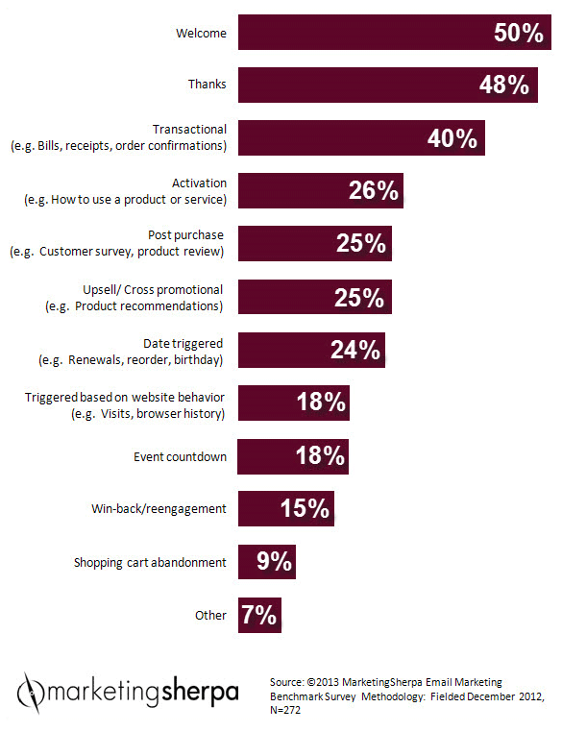
1. Autoresponders Nurture Your Leads
With autoresponders, you have the opportunity to start building relationships with your leads from the moment that they join your list.
You can offer them value straight away by providing valuable information, insights and teaching them how to make better decisions via an automated on-boarding process.
As opposed to a one-off email broadcast, which will only go out to the people who are currently on your email list, having an autoresponder ensures that everyone gets to see your best content, and everyone gets their own unique, personalized experience.
2. Autoresponders Turn Prospects into Customers
Your ultimate goal, of course, is to turn your email subscribers into paying customers. And that’s exactly what autoresponders do best.
Autoresponders allow you to build “know, like and trust” before you ask for the sale. That way, you can convert more customers, and you can do it without being overly “salesy” or pushy.
An autoresponder series is also an essential tool for increasing anticipation building up to a launch, and incorporating scarcity into your campaigns.
Autoresponder Emails Build Trust

Slide 30
How to deliver in InBox
Tips for mail delivery in INbox

Slide 31
Find out your sender score: Sender score is a credit score that tells email providers and spam filters how wanted your emails are and trustworthy they are. It can range from zero and hundred. This score changes every day. Checking this score on a daily basis is important to avoid any deliverability surprises. You can check sender score, using these services- SenderScore and SenderBase.

Slide 32
Optimize your emails for all devices: Marketers need to design email programs and emails which can be read on multiple devices. A responsive email template ensures good rendering on mobile devices too. Apart from this, make sure you are sending a text-based email too; these emails render quite well on any mobile device.

Slide 33
Try to send emails from a dedicated IP address: Using a dedicated IP address can help to land emails into inbox thereby increasing your deliverability rates. When your emails send rates reaches a certain volume, it is advisable to switch to a dedicated IP address. This can help you in gaining control over your reputation and subsequently helps in gaining high email delivery.

Slide 34
Make it mandatory to authenticate your sending domain: To protect your brand from fraudsters consider authenticating your sending domain. Authenticating helps to identify ownership of your mailing domain. Your sending domain should have proper SPF, DKIM and DMARC records implemented. Using these records escalates the sending domain reputation thus, in turn, helps you achieve high email delivery.

Slide 35
Make sure that your users have the option to unsubscribe: Give your subscribers the option to leave when they sign up to your updates. This is an important factor to make your audience stay. Make sure your outgoing email campaign has an unsubscribe link. Also, make sure that the email campaign has Link-unsubscribe: in the email header. Having Link-unsubscribe: in header enables subscribers to unsubscribe the emails quickly.

Slide 36
Monitor your email sending reputation from Google Postmasters: You should configure your sending domain name with your Google Postmasters account, then, keep an eye on domain reputation and IP reputation tab. High domain and IP reputation in Google Postmasters, ensures high email delivery. Feedback Loop and Delivery Error are another important options; you should also keep a close eye.

Slide 37
Double check if all your URL’s are working: Use an automated URL tester and blacklist checker to run your URL’s and discover potential issues before you hit send. A non-working link inside the email, cause very bad reputation in front of the subscriber. Also, this raises suspicion to the mailbox provider and decreases the email delivery to the inbox.

Slide 38
Ask users to add you to their contact list : This method is useful in targeting high email delivery and ensures they enter your customer’s inbox. Microsoft mailboxes- MSN, Live, Outlook, Hotmail, take this on priority before it enables emails to land in the inbox of the subscriber.

Slide 39
Try sending test emails before sending to the main list
Sending test emails can help you determine the reactions of the subscribers beforehand. These test emails could be sent to the small group to test if you land emails into the inbox. In the case of a failure, report the program could be changed easily, and this would ensure lower damages. Or, you can also send a test email to mail-tester.com service, which enables you to check any potential issues with your campaign at once!

Slide 40
Some other tips
Here are several tips to follow and adopt to improve your reputation and deliverability:
Sender Addresses:
✗ Avoid using free web-based email addresses (Gmail, Hotmail, etc) for your sender addresses.
✓ Use custom domain email address that is linked to your website. You will then be able to setup DKIM & SPF, which will allow for email authentication by the recipient servers.
✓ Ensure your website is active and running. Sending email from an address that is linked to an inactive or blank website will make ISPs suspicious.
Contact Lists:
✗ Do not purchase, borrow or copy any third party contact lists. Not only do these types of lists typically contain many spam traps and poor quality email addresses, it is against our policies. (A spam trap is an email address that is not used for communication and it should never receive emails; if it does receive email, then it is considered to be spam.)
✓ Develop good quality contact lists by collect email addresses via an opt-in from your website. A double opt-in process is recommended to eliminate mis-typed or fake email addresses.
✓ Regularly update and clean your contact lists. Monitor your mailing results, and remove older non-engaging or blocked email addresses. Focus on the people who are most interested in your newsletters.
Emails Contents:
✗ Do not use ALL CAPITALIZED WORDS in your subject line or body.
✗ Avoid using spammy type words (‘Free’, ‘Sale’, ‘Cash’, ‘Limited Time Offer’, etc).
✓ Keep your subject line between 35 to 50 characters long. The longer your subject line, the more likely it will be flagged as spam.
✓ Send content that your subscribers have signed up for and are expecting. If you send non-relevant content, your subscribers may mark you as a spammer. And the more people that open your newsletters, the better your reputation.
✓ Send your newsletters consistently.

Slide 41
Google Postmaster Tools
If you send a large volume of emails to Gmail users, you can use Postmaster Tools to see:
If users are marking your emails as spam
Whether you’re following Gmail's best practices
Why your emails might not be delivered
If your emails are being sent securely

Slide 42
5 Ways to Check Your Sending Reputation
SenderScore.org
Like a credit score, a Sender Score is a measure of your reputation. Scores are calculated from 0 to 100. The higher your score, the better your reputation and the higher your email deliverability rate. Numbers are calculated on a rolling 30-day average and illustrate where your IP address ranks against other IP addresses. This service is provided by Return Path.
Senderbase.org
Senderbase is a product of Cisco and provides you with the tools to check your reputation by ranking you as Good, Neutral, or Poor. Good means there is little or no threat activity. Neutral means your IP address or domain is within acceptable parameters, but may still be filtered or blocked. Poor means there is a problematic level of threat activity and you are likely to be filtered or blocked.
ReputationAuthority
WatchGuard’s ReputationAuthority helps protect business and government organizations from unwanted email and web traffic that contain spam, malware, spyware, malicious code, and phishing attacks. You can look up your IP address or domain, receive a reputation score from 0-100, and get the percentage of emails that were good versus bad.
BarracudaCentral
Barracuda Networks provides both an IP and domain reputation lookup via their Barracuda Reputation System; a real-time database of IP addresses with “poor” or “good” reputations.
TrustedSource
TrustedSource is a site very similar to senderbase.org, but run by McAfee. It provides information on both your domain’s email and web reputations as well as affiliations, domain name system (DNS), and mail server information. It also provides details on the history, activation, and associations of your domain.

Slide 43
Email A/B Testing
“A/B testing your email campaign”
Email A/B testing is basically pitching an email campaign with another version of the same email campaign by making changes to only one element. One version is sent to a set of subscribers and the other to another set of subscribers. The victor is decided based on the metrics collected.
The effectiveness of A/B testing your email campaigns lies in the fact that even though there isn’t a drastic change happening in the email by changing a single element, there can be a tremendous change in the response rate of the campaigns.
Moreover, for accurate results, it is essential that you change only one element at a time. For testing more than 2 versions of the email simultaneously, Multivariate Testing is the best approach.
What elements can be A/B tested?
An email is made of several little components and there is a possibility to test each and every one of them. But marketers generally tend to test the following components:
Call to action
Subject line
Layout of the email
Customer reviews or Testimonials
Personalization opportunities
Body text
Image placement
Time & Day of the send
Rich media email vs. Plain text (yeah even this matters)

Slide 44

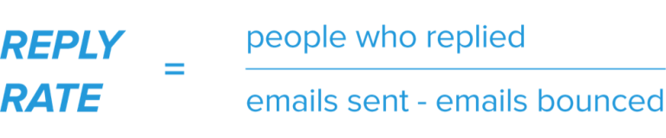
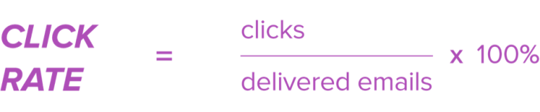
What to test in A/B test
You have three options:
1. Open Rate — Which email variation was opened by the most people?
2. Reply Rate — Which email variation did more people reply to?
3. Click-Through Rate — Which email variation was more effective at getting people to click on linked content?

Slide 45
https://aritic.com/blog/aritic-pinpoint/inbox-high-email-delivery/

Slide 46
Email Preview Test:
https://litmus.com/email-testing
Google Postmaster
https://gmail.com/postmaster/
https://www.senderscore.org/
https://www.mail-tester.com/ (Test the Spammyness of your Emails)

